Slide 1

L6 Group-1 Pitch 5
Caitlin White, Connor Wilby, Jamie Chandler and Jordan Marks

Slide 2
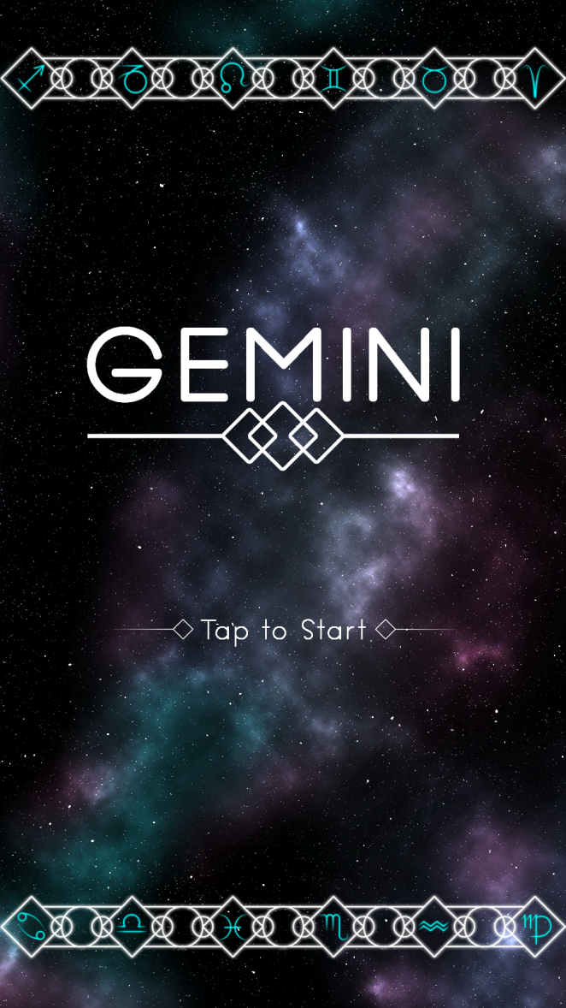
Our Brief
Mobile Platform
Potential for monetisation
Inclusion of smart depth
CW

Slide 3
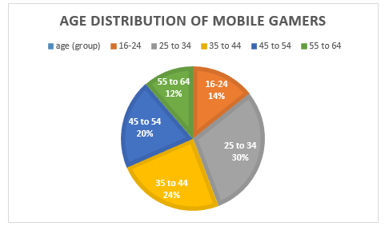
Demographic
Age: 25-44
Gender: Female
Source: http://www.realitymine.com/myth-busting-mobile-gaming-demographics/
JM

Slide 4
Psychographic
Emily
Favourite colour: Purple
Enjoys her own casual style
Enjoys shopping and reading in her spare time
Enjoys matching games
Times she spends each day on games: 2 hrs
Enjoys using social networks in the evening when she gets home to connect with her family and friends
JM

Slide 5
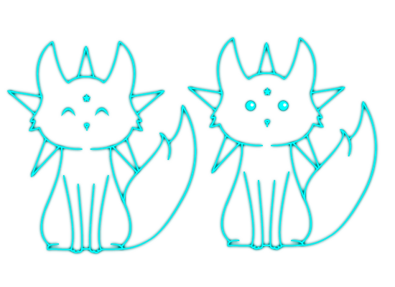
Platform and Genre
Platform: Mobile and Tablet
Genre: Hex based Puzzle
Duration: Up to 5 minutes
CW

Slide 6


Game goal and Features
Creating an unbroken chain of hexes
Optimisation game
Each starsign having a unique mechanic
JC

Slide 7
The Game Loop
Level start
Move tiles
Complete level
Earn rewards
JC

Slide 8
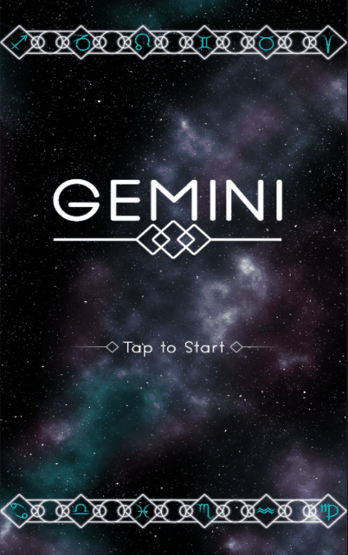
Gameplay

Slide 9
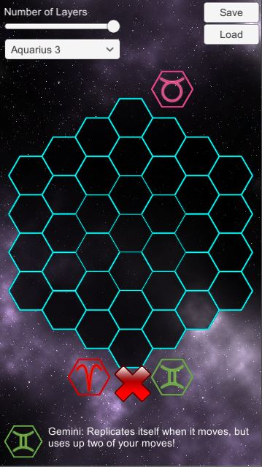
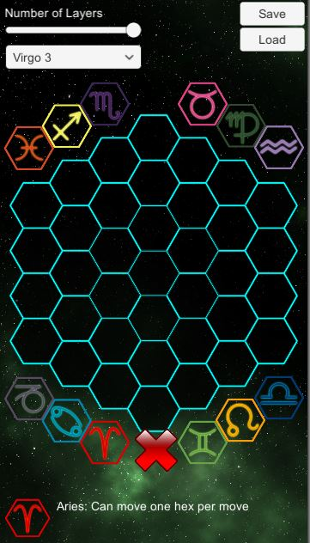
Level Editor
CJ

Slide 10
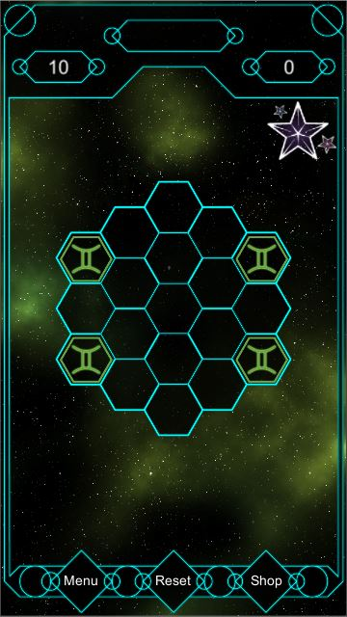
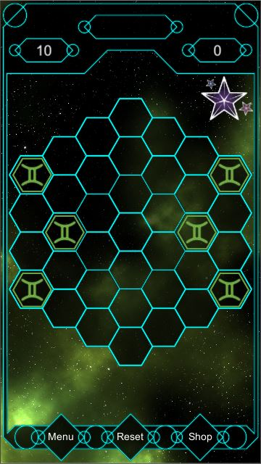
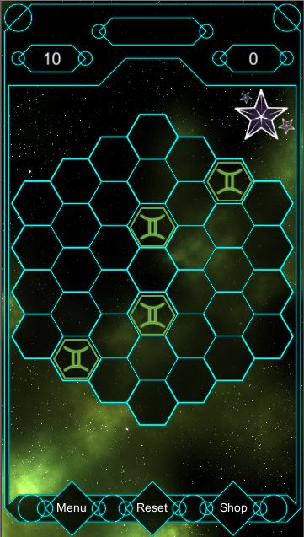
Levels - Gemini
Cloning/snake movement
JC

Slide 11
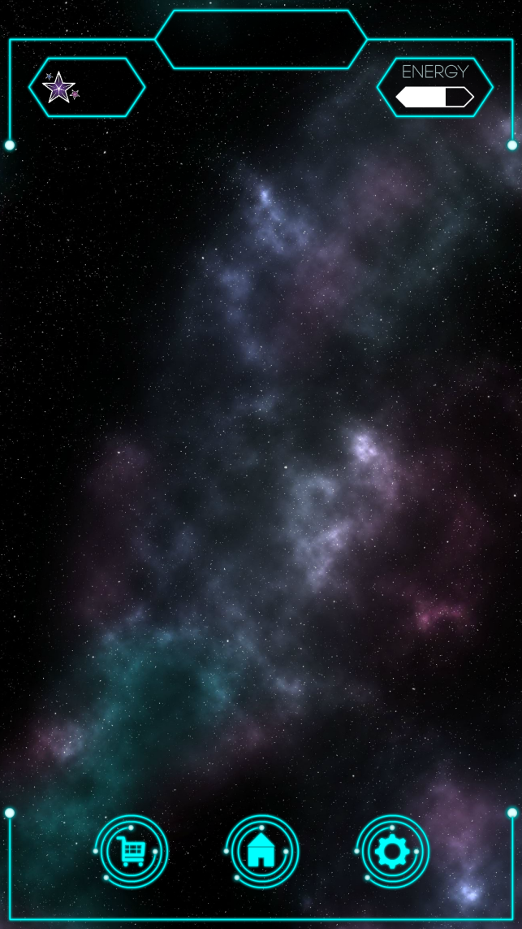

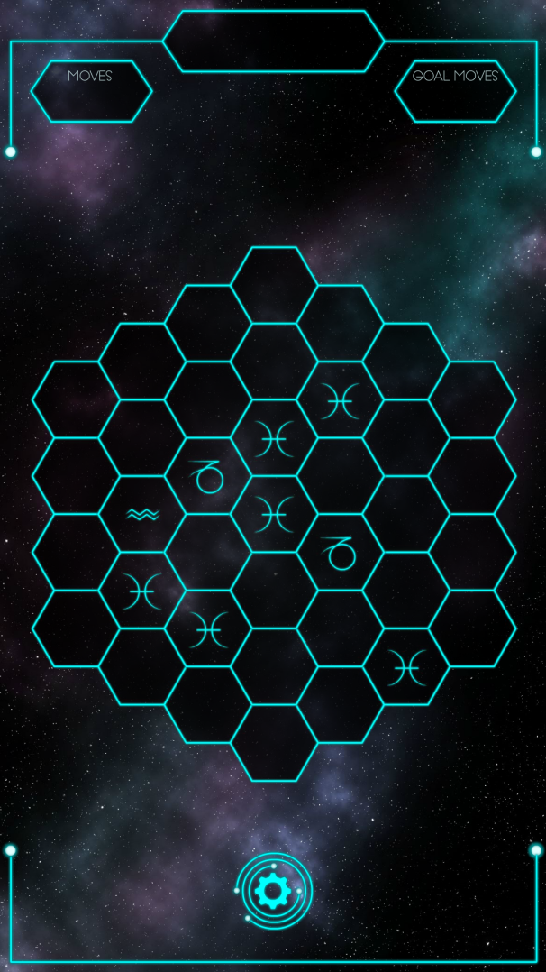

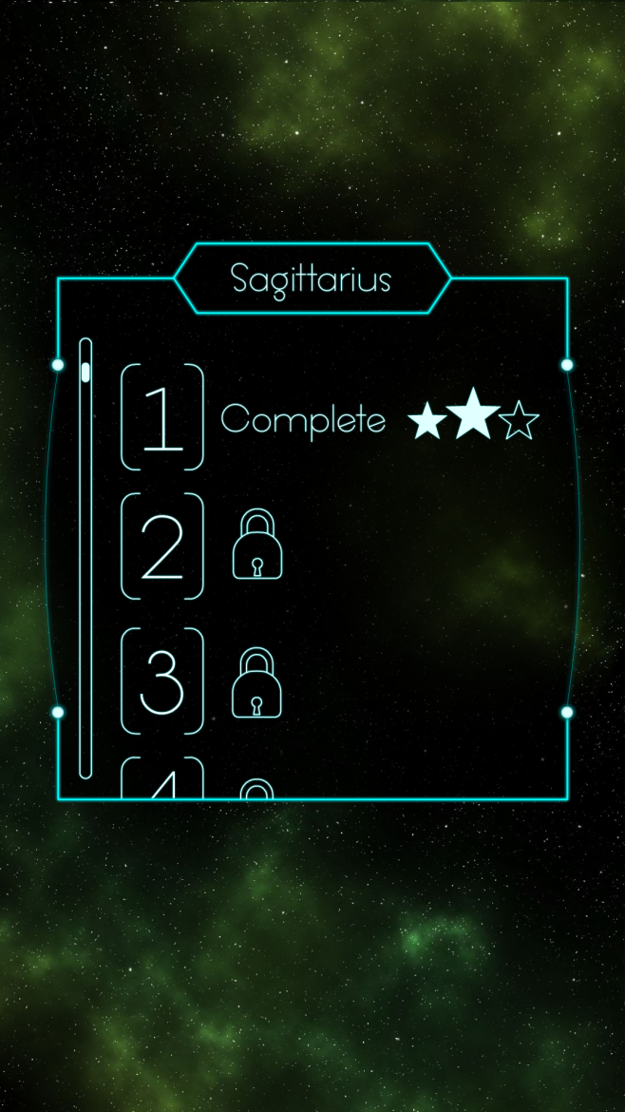
Reworked UI
CW

Slide 12

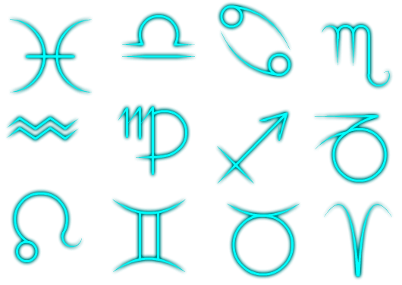
Tile Mechanics
Basic single movement
Cloning movement
Knight movement
CJ

Slide 13

Currency & Power Ups
Stardust
Pricing from 99p to £59.99
Refill Lives/Stamina
Power-ups
Extra Moves
Place an extra symbol
Hint outline
Daily Login bonuses
JM

Slide 14

Feedback - Strengths
Liked theme
Good hex grid sizing
Easy to play – buttons are good size to tap
JM

Slide 15

Feedback - Weaknesses
Unclear what to do at first glance
UI still a bit unclear
Balancing
JM

Slide 16

Moving forward...
Further playtesting and balancing
Finish implementation of UI
Further polish
JC

Slide 17
Questions?

